Slide 1
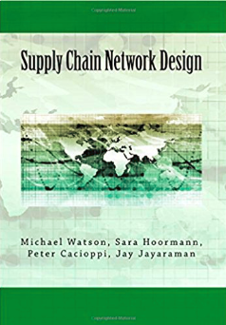
Supply Chain Network Design Chapters 3, 5, 6, 7, 8, and 9

Slide 2
Chapter 3: Consider Only Distance

Slide 3
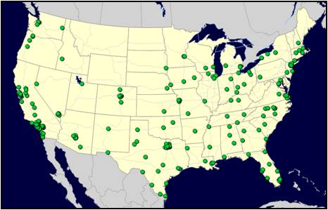
Al’s Athletics – Corporate Background
In the late 1960’s, Al Alford decided to open a business catering to the young potential sports stars in his small town of Brownfield, TX. The first sporting goods store was such a success that the Alford family soon added many more stores in similar small towns across the south.
50 years later Al’s Athletics is one of the largest retail sporting-goods chains in the US and now has major retail-store outlets in 41 states.
Store/Customer Map for Al’s Athletics
Competition in the sporting goods market is currently very high and Al’s grandson, who is now in charge of the company, realizes that they must find ways to offer better service and lower their transportation costs in the face of ever increasing fuel prices.
Based on the initial benefits the company realized by adding a single warehouse in Lubbock, TX, Al the Third decided that Al’s Athletics needed to add more warehouses to service the rest of the markets across the entire US.
The question was… how do they determine the ‘best’ number and location for these additional warehouses?

Slide 4
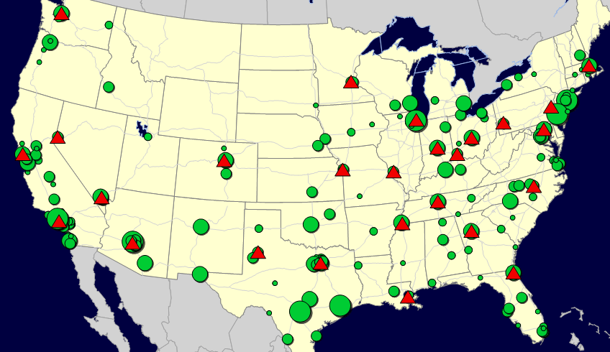
Al’s Athletics – Problem Definition
Al’s team decided to use a commercial Network Design application to find help them find the optimal answer to their question.
The team generated a list of 24 potential locations where they could easily enter contracts with a 3PL to lease space within their existing facilities. You can see these locations plotted on the network picture below.
Their study needed to consider not only the geographic location of all the stores but also consider their relative importance based on their ‘demand’ or amount of product required by the customers shopping there. (Think of the similarity of this to weighting potential Logistica capital city locations by population in our previous modeling)
22 Potential Warehouse Locations plotted against Customer Locations sized by Relative Demand

Slide 5
Definition of “Customers”
When modeling a supply chain, we will use the term “customers” to refer to the endpoint of the supply chain
That is, the point we need to deliver to
The “customer” need not be an end consumer or even a single entity.
For example, in Al’s, the “customers” are the collection of stores in a given city
In general, what do you think we could model a “customer” as? In other words, if your data has a row for each customer, what should the row be?
Stores
ZIP or Postal codes you deliver to
A pool point where goods are consolidated for final shipment to the store
Another company’s warehouse or manufacturing site
Your own final set of warehouses (if the customer assignments don’t change)
A port of exit
And, so on…

Slide 6
Definition of “Demand”
Once we have customers, we need to assign each customer a “demand”
What are different ways you could think of modeling demand? You have customers. What else is demand indexed by? What units do you use?
In this case, we define the “demand” as the total amount of product we need to get to each customer in the time horizon of the model
Time horizon is usually annual (to capture seasonality)
Units: Total amount of product is measured in a way that makes sense for logistics (or for the problem)
Total weight
Total cases
Total pallets
And, so on…
(But, not total revenue)
We will talk about products later, but this can refer to groups of products, not necessarily (and almost never) individual items (same reasons as with customers)

Slide 7
We are going to save the running of this model until the lab
You’ll see this in PuLP
Keep in mind:
The models were meant to be run by people who didn’t know Python
The models were written in PuLP so we didn’t have to worry about people getting commercial software

Slide 8
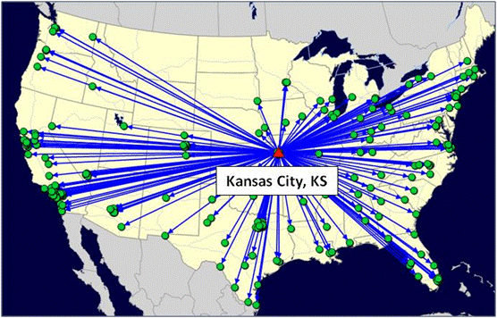
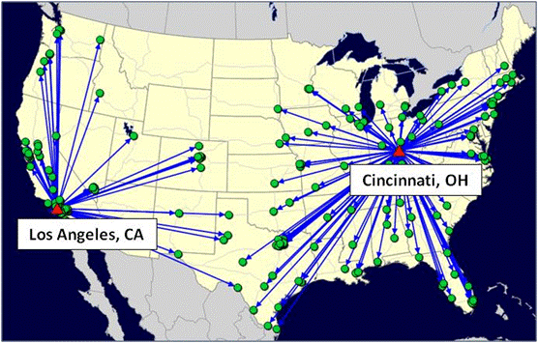
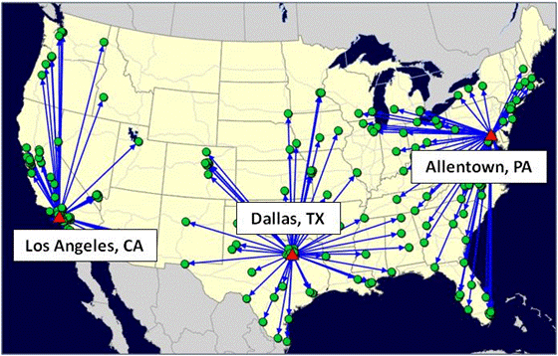
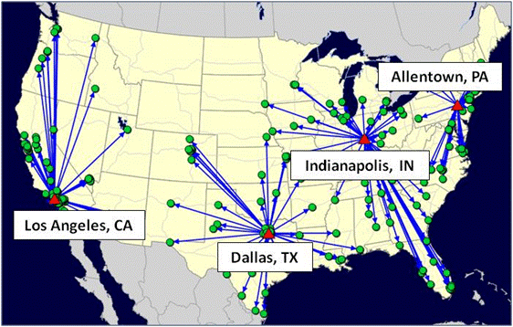
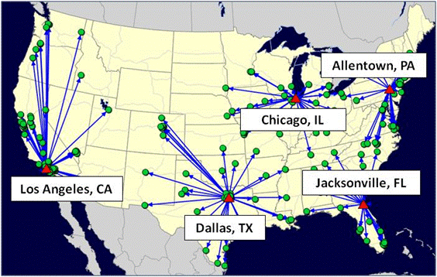
Al’s Athletics – Scenario Results Best 1-5
Best 1 Warehouse
Best 2 Warehouses
Best 3 Warehouses
Best 4 Warehouses
Best 5 Warehouses

Slide 9
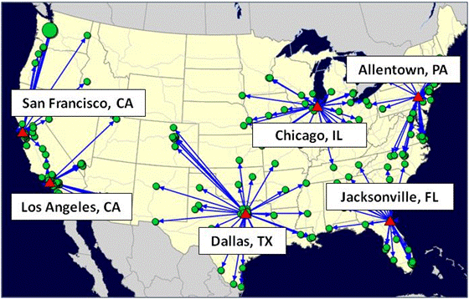
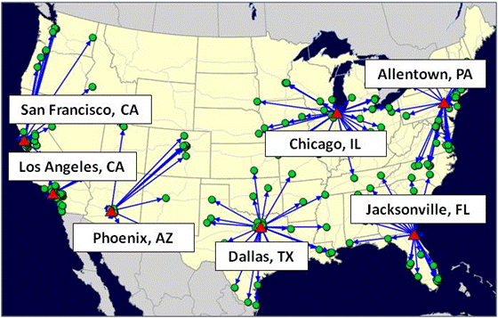
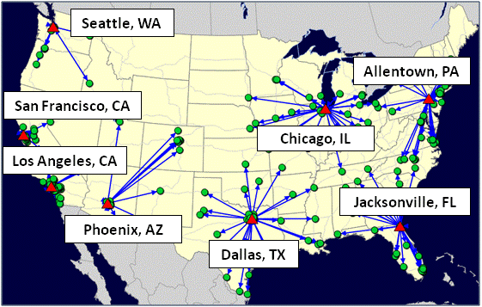
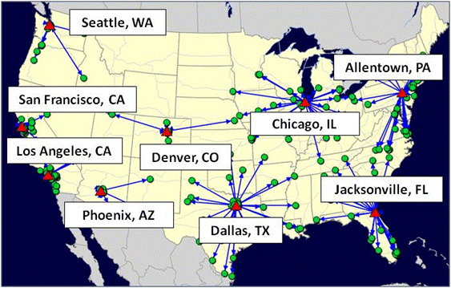
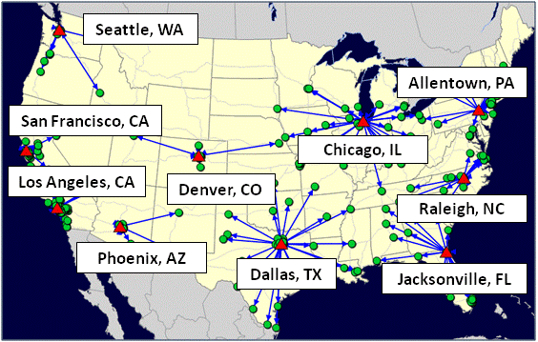
Al’s Athletics – Scenario Results Best 6-10
Best 6 Warehouses
Best 7 Warehouses
Best 8 Warehouses
Best 9 Warehouses
Best 10 Warehouses

Slide 10
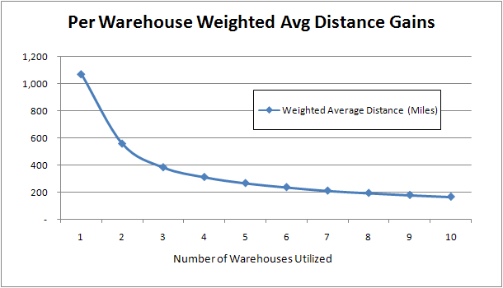
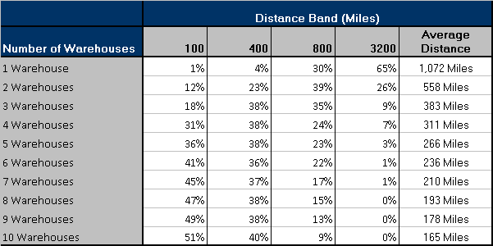
Al’s Athletics – Scenario Comparisons

Slide 11
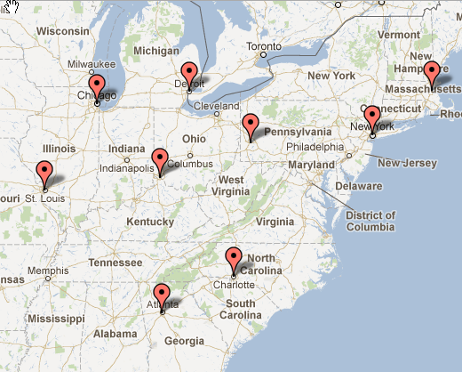
Don’t Be Intimidated by the Math Formulation
Going through the math formulation helps you systematically understand how to approach these problems
Just knowing about the math formulation allows you to think logically about the problem
We use the math formulation to help you build intuition
We will take you through the math formulation, step-by-step, with the MIP 9-City example
MIP 9-City Example
Use the spreadsheet from the book Web site
This simple example has 9 U.S cities, see map to the right
This problem is like Al’s, except much smaller
Map source: geobatch.com

Slide 12
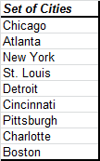
Terminology- Customers
We have a set of customers we want to serve. We call this set “J” (the capital letter J). If we use lowercase j, we are referring to an individual customer
In the MIP 9-City Example, the set J is the full list of customers (this list can be found in cells A14:A23)
A single customer in this list is referred to as j (lower case j).
We do this so we can formulate a general problem that will work for any number of customers.
Once a solver engine starts to work, it will internally number these items. So Chicago will be j =1, Atlanta j = 2, and so on. But, we don’t need to worry about that when we formulate the problem.
All these customers are referred to as J (capital letter J)

Slide 13
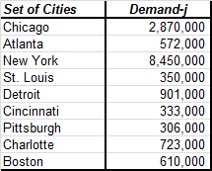
Terminology- Demand
In our formulation, demand occurs at a customer. We refer to demand d (lower case d) and append a subscript to indicate which customer. So, demand at a customer is d_{j}.
Now, you can see why we used the lower case j for the customers– this gives us a way to indicate, with just two letters (d_{j}), that we have demand at each individual customer
In the MIP 9-City, this is seen in cells B14:B23 (there is a typo in the book where we put an i instead of a j)
We only needed the demand column, but we are showing the customers as well so you can see the demand by customer

Slide 14
Terminology- Facilities
We have a set of facilities we want to pick from to serve customers (these can be warehouses, plants, etc). We call this set “I” (the capital letter I). If we use lowercase i, we are referring to an individual facility
In the MIP 9-City Example, the set I is the same list as the customers (this list can be found in cells A14:A23)
The list doesn’t have to be the same. It is different in Al’s.
When the solver engine runs, it treats the list of cities as two tables
A single facility in this list is referred to as i (lower case i).
We do this so we can formulate a general problem that will work for any number of facilities.
Once a solver engine starts to work, it will internally number these items. So Chicago will be i =1, Atlanta i = 2, and so on. But, we don’t need to worry about that when we formulate the problem.
All these cities are both customers and potential facilities. They are referred to as I (capital letter I)

Slide 15
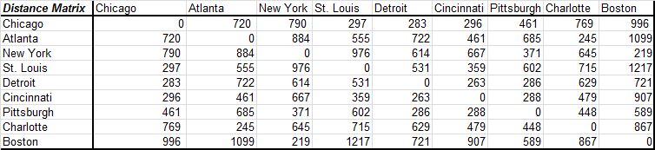
Terminology- Distance Matrix
In this formulation, we are concerned about the distance between facilities and customers. We need a distance matrix that shows us every combination. We call this dist_{i,j}
The term dist refers to the fact that this term represents the distance. The i,j subscript tells us that it is the distance between facility i and customer j.
Again, we see the value of the set names. With the word dist and two letters (i and j), we can compactly represent a distance matrix that can be as small as 1 record or as large as millions (or more).
Note that is an input to the model
We have provided the distance matrix cells A40:J49
In practice (like in Al’s), this can be generated automatically (but, it needs to be generated)

Slide 16
The Objective of the Optimization
We want to minimize the average weighted distance from the facilities to the customers
This is equivalent to minimizing the total weighted distance, but the average is easier to understand
We are using demand to as our “weights”

Slide 17
The Constraints of the Optimization (1)
We have to meet all demand
If we don’t have this, we could reduce distance by not meeting demand
We can only locate a certain number of facilities. We will call this number P.
This allows to us to determine the best 1, 2, 3, and so on facilities
Why do we need to limit the number of facilities (P), why don’t we let the optimization give us the best number?
In this model, without a limit, the model may just select every facility

Slide 18
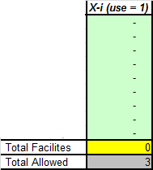
The Decisions of the Optimization (1)
Do we pick a particular facility or not?
We will designate this decision as X_{i}.
Remember the i indicates one of the potential facilities
We will allow X_{i} to take on two values, 1 or 0. If it is 1, it means that this facility is used in the solution. 0 it is not.
This is a binary variable because it is either 1 or 0. In this case, it does not make logical sense to open ½ of a warehouse
The X_{i} variables can be seen in cells C14:C23. Note that we add this column and compare it to the total allowed, P.
When we run the optimization, we will be trying different combinations of facilities (by putting a “1” in different places) and seeing what the average distance is. Mathematical optimization has systematic ways to do this.

Slide 19
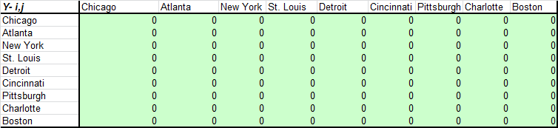
The Decisions of the Optimization (2)
Which customer is assigned to which facility?
We will designate this decision as Y_{i,j}.
Remember the i indicates one of the potential facilities and j one of the customers
In this case, to start, Y_{i,j} can only be 1 or 0. If it is 1, it means that customer i has all its demand met from facility j.
The Y_{i,j} variables can be seen in cells A27:J36.

Slide 20
The Constraints of the Optimization (2)
Now, that we have defined the decisions, another logical constraint becomes obvious:
If a customer is served from a facility, then that facility must be opened
This constraint will tie the X and Y decisions together. This constraint forces the solver to pick the best values of X and Y at the same time
We will cover how to mathematically write this constraint in a few slides– this constraint will be an example of writing an IF-Statement using algebra

Slide 21

Formulating the Math Problem: The Objective Function (1 of 3)
Our objective is to minimize the total weighted distance from facilities to warehouses. Mathematically, we express this as:
If two variables are next to each other, we are using the standard algebra notation meaning we multiple them together.
So, in this case, we multiple distance times demand times Y: dist_{i,j} d_{j} Y_{i,j}
The summation sign (Σ) means sum the terms,
The “∈” means element. So, under a summation sign, we need to know what we are summing over. “i ∈I” means we sum up each of the individual facilities and “j ∈ J” means we sum up over every individual customer in the customer list. (In Excel, we specify the cells we want to sum over. Here we can it in a more general way without having to know the specific cells).
Minimize

Slide 22
Formulating the Math Problem: The Objective Function (2 of 3)
Our objective is to minimize the total weighted distance from facilities to warehouses. Mathematically, we express this as:
So, for any possible values of Y_{i,j} we can determine the value of the objective function:
For every possible combination of i and j, we can simply multiple out the term: dist_{i,j} d_{j} Y_{i,j}
We then add up all these values (we need two summation signs because we have to add up every possible i value and every possible j value
Minimize

Slide 23
Formulating the Math Problem: The Objective Function (3 of 3)
Our objective is to minimize the total weighted distance from facilities to warehouses. Mathematically, we express this as:
Now that we know how to find the value of the objective function, we want to try different values for each of possible Y_{i,j} combinations to see which one gives us the lowest total number
We use mathematical programming for this (but could try a few by hand)
If we don’t define anything else but this equation, what will the solver do?
Set the Y variables to very large negative numbers..
If we make the Y variables 0 or 1, what will it do?
Set every Y to 0…
You can see that we’ll now need to guide the solution with constraints. Once we do this, how would you describe how the solver chooses to set a Y variable to 1 rather than 0?
Sparingly, grudgingly, miserly
If you give the solver an escape route, it will set it to 0
But, if you are overly cautious and make mistakes, it may be forced to set them all to 1!
Minimize

Slide 24
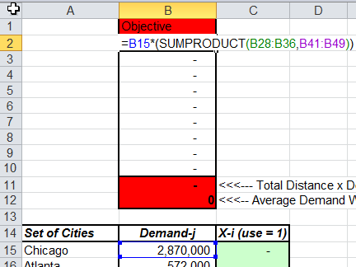
Formulating the Math Problem: The Objective Function (practice)
The mathematical notation allows us to write a compact objective function:
In Excel, there are many ways to do this. Go to cells B1:B11 to see one way
Minimize
In cells B2:B10, we are multiplying the demand (B15) by the distance (B41:B49) by the Y_{i,j} variable (B28:B36). We are also taking care of the summation over all customers (J) with the SUMPRODUCT function. In effect, we have locked in a value for i (by just taking one column of the Y_{i,j} table.
To include the second summation, we just sum columns B2 to B10.

Slide 25

Constraint: Every Customer Must Be Served
To ensure every customer must be served, we need a constraint for every customer . We can compactly write this as:
The symbol, ∀, means “for every.” So, in this case, we have a constraint for every individual customer in the full set of J customers.
So, for each of these constraints, we sum all the Y_{i,j} values over all possible values of i (but remember, j is fixed for any one constraint). This value must add up to 1 (think of 1 as 100% of the customer demand)
How do we ensure we are meeting all the demand? (For example, demand may be 1556, or 4.5 million, etc?
This is covered in the objective function where we multiple out the demand with the Y variabile

Slide 26
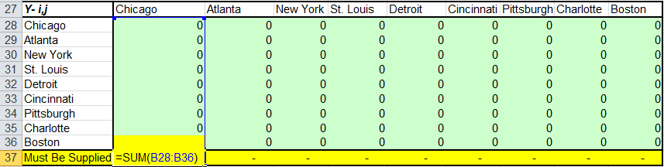
Constraint: Every Customer Must Be Served (In Excel)
To ensure every customer must be served, we need a constraint for every customer . We can compactly write this as:
In Excel, each column represents the “∀ j ∈ J” part– one constraint per customer
The summation in row 37 the sum over all the Y_{i,j} for a given j value.
Each cell in row 37 must equal 1. So, in this case, there are 9 constraints

Slide 27

Constraint: Pick Just P Facilities
To ensure we pick just P facilities, we need the following constraint
We just sum up over all possible facilities and this number needs to equal P
In Excel, this is relatively simple (in C14:C25)
We sum up all the X values
And, it must equal P

Slide 28

Constraint: If a Customer is Served from a Facility, That Facility Must Be Opened
We need to ensure that if a customer is served by a facility, then that facility is open. (These constraints link X and Y together). This is a family of constraints. You need a unique constraint for every combination of i and j. They are written as follows:
Here is a thought exercise to understand this constraint
We have a constraint that says a customer must be served 100%.
In our objective function, for a given customer (a given j), we want to set a Y_{i,j} equal to 1 where the distance is low, and set all the other Y_{i,j} ‘s for that customer to 0 so we can keep the objective function low.
We could pick the best Y_{i,j} for each customer in that way.
If we do this, we will likely find that the Y_{i,j} ‘s we set to 1 will have all kinds of different values for i. That is, some will correspond to Chicago, some to St Louis, some to New York and so on.
This would lead to opening more than P sites.
We don’t (yet) have a way to prevent this.
This constraint says that if we want to set a Y_{i,j} to 1, then we need to look at the X_{i} value (for the same i) and make sure that is at least a 1.
Since we have a constraint that limits the number of X variables we can pick, this family of constraints forces us to choose wisely.
This is a lot like an IF-Statement

Slide 29

Constraint: X and Y must be 0 or 1
We have two more simple constraint sets that tell the solver to set X and Y to 0 or 1
Later, we can relax the Y restrictions, but for now this tells us the valid values for X and Y

Slide 30
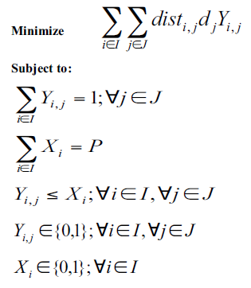
The Full Math Program

Slide 31
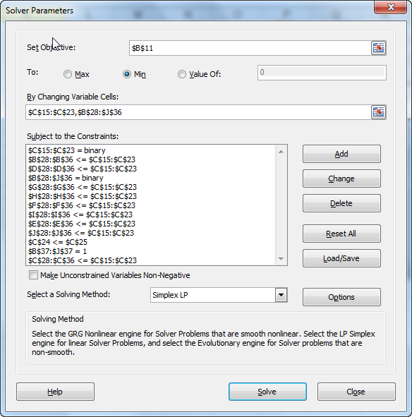
The Same Problem in Excel: is not as generic)
There may be other ways to formulate this in Excel, but it does get harder to scale and read complicated models.
*
* All the unmarked constraints in Excel belong to this family of constraints

Slide 32
Lessons Learned
Even with just distance, the problem is realistic
In some supply chains, being as close to the customers is the primary goal
Distance is a good measure of the speed of delivery and an approximation of transportation costs
Even just considering the distance, when you locate more than one facility, the problems become more complex
The mathematical formulation gives us a logical way to think about the problem and a method for feeding the problem to a commercial solver or Excel
Running multiple scenarios is a good way to understand the impact of changes in the supply chain and the marginal value of additional sites

Slide 33
Chapter 5: Capacity

Slide 34
Every Supply Chain Has Capacity
Why not include it in the model
Demand may naturally be distributed across your facilities
Capacity may be relatively inexpensive to add
Decisions are for the long term
Why include it
You are making decisions about expensive plants, warehouses, or lines
You are making decisions around highly automated facilities or equipment
You are determining number of shifts to run

Slide 35
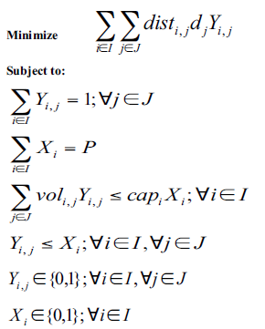
Formulating Capacity
There are many ways to add capacity to the formulation.
We will show just one that is most related to the warehouse (but could be used for simple plants).
We will stick with our objective from Chapter 3.
We only need to add one constraint.

Slide 36

Capacity Constraint Explained
Our new term is of vol_{i,j} which is the amount of capacity consumed at facility i when customer j is assigned to it. When Y_{i,j} is assigned a 1, vol_{i,j} is used. The summation is over all the customers. So, we want to the total capacity consumed for all the customers assigned to a facility.
Our new term here is cap_{i} which is just how much capacity we have available to us. This is why you need to make decisions on how to measure capacity.
There is a constraint for every facility
35

Slide 37
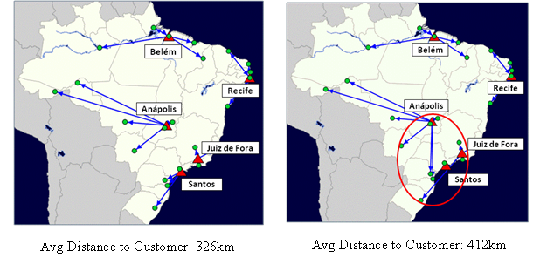
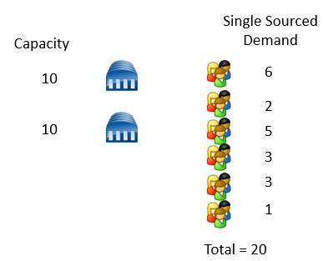
Difficulty with Capacity Constraints
Capacity constraints can cause an infeasible model
If total available capacity required is more than available
Can show up if you do not allow enough facilities to open or if the facilities are not large enough
Capacity constraints can cause strange-looking results
See Figure 5.2. With capacity constraints, Anapolis serves customers that are closer to another warehouse
Capacity constraints can act like the knapsack problem

Slide 38
Chapter 6: Transportation Costs

Slide 39
Adding Costs to the Model
Transportation is the first cost we add to the model
It is often the most important cost
It is most often the cost most impacted by network design
We will focus on “outbound” transportation
This is the cost to ship from the final facility (a warehouse or plant) to the final customer
The inbound transportation is the cost to ship product into the warehouse or plant. We cover this in a later chapter
We will cover the modes of transportation, which will apply to both inbound and outbound
Transportation costs are related to distance, but not completely. Why?
Minimum charges
Regional difference
Different modes of transportation and shipment profiles

Slide 40
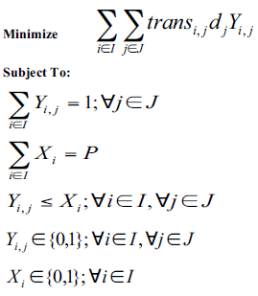
Formulating Transportation Costs
The problem is almost the same as the practical center of gravity, except we use the transportation cost (trans_{i,j}) and not distance
Objective:
Minimize total transportation costs
Constraints
Meet all demand
Open just P warehouses or plants
If you use a site, you must use it
Decisions
Y_{i,j}– which customer is assigned to which plant or warehouse. Here we force this to be 0 or 1, meaning we single source the customer
X_{i}– which plant or warehouse is open

Slide 41
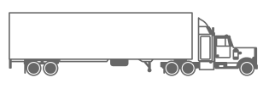
Question
Are we modeling every single shipment?

Slide 42
Three Important Facts About Transportation Costs To Help You Understand the Model
Demand is expressed in total
Transportation costs are expressed in per-unit costs
You need a transportation cost for every source-destination pair you would like to consider

Slide 43
Demand is Expressed in Total
For each customer point we typically express demand as the total annual demand
A customer point is typically a collection of actual ship-to locations rolled up by geographic proximity (all the customers in Miami)
We don’t have to use annual demand, but could use Quarterly or Half a Year, depending on the circumstances
We don’t model every single shipment
Model would become too large to manage, solve, and analyze
Model would not be more accurate anyway– we cannot forecast next year’s demand at the shipment level
But, we can be creative when we set up the customer points and demand to capture reality
Break up customers by types of shipments
Break up customers by importance
(More tips in Chapters 12 and 13)

Slide 44
Transportation Costs are Expressed in Cost Per Unit
If we didn’t express in cost per unit, we would be back to modeling every shipment
Once we have the cost per unit, we can easily scale the model up or down (with more or less demand) (But, be careful when assumptions might break!)
Different trucking and shipping companies will express their rates differently
We can convert many different rates to a cost per unit

Slide 45
Chapter 7: Fixed and Variable Costs

Slide 46
Fixed and Variable Costs in a Model
Fixed Cost in a Model– a one time charge for using or opening the facility
Variable Cost in a Model– a charge per each unit that is processed by the facility
There is no such thing as a variable cost
There is no such thing as a fixed cost

Slide 47
How Fixed and Variable Costs Work in the Extreme
If all costs are modeled as fixed…
If all costs are modeled as variable…..
The model will tend to minimize the number of facilities used and once a facility is opened it will maximize the amount of product it sends through that facility
The model has an incentive to use every facility so that it can minimize transportation costs. The model will send one unit through a facility if it reduces transportation costs

Slide 48
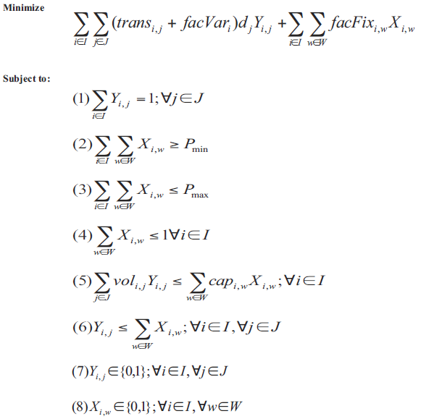
Mathematical Formulation for Fixed and Variable Costs
The biggest changes to the model is adding the facility fixed and variable costs to the model (facVar and facFix)
The fixed and variable costs are now included in the objective function and added to the transportation costs
To capture the step sizes, we’ve added an option variable (W) to the model. You can see that the X variable is indexed by this. Think of this as giving the model the open a large, medium, or small warehouse at location X.
We have a capacity limit on the warehouse (helpful when you have options), as well as a min and max number of warehouses (optional)

Slide 49
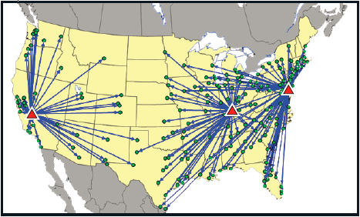
Notes on Facility Variable Costs
If the variable cost at each facility is the same, it doesn’t impact the solution
If variable costs are different at each facility, then the model has an incentive to use the lower costs facilities and pay more in transportation costs (see map)
If the difference between variable costs at the facilities is high, the model will tend to make assignments based on variable costs and not transportation
The mathematical formulation shows a single variable cost, but in practice, you may end up breaking this into different categories
With the lower variable cost, the warehouse in the east serves a larger territory

Slide 50
Notes on Facility Fixed Costs
Keep in mind that you can get some of this data without modeling it
It is important to model when
There are significant differences between sites
You want to model size options
You are making significant capital investments or investment in capacity (this is typical of manufacturing studies)
The fixed cost can include
One-time capital investments (like buying equipment, a building, or land)
On-gong fixed costs (like management, utilities, or upkeep of the buildings)
It is important that your fixed costs are based on the same time period as your variable costs
If it costs $10M to build a site, but you depreciate that over 10 years, you need to annualize the $10M

Slide 51

Your Accounting System Was Not Created to Help You Build Supply Chain Network Design Models
The data in your accounting system may not be what you need for your network design model
You want to model fixed and variable costs to make the right decision for the supply chain
The accounting system may have data on fixed and variable costs that allocates costs in ways that will distort your model
It is important to go through the accounting data and decide how to split the cost categories into your fixed and variable costs

Slide 52
Summary- Lessons Learned
Adding fixed and variable costs adds a new level of sophistication to the models
You need to carefully decide how to model costs and fixed and variable
Do not necessarily go with the accounting definitions.
Categorize the fixed and variable costs based on how they will impact the model

Slide 53
Chapter 8: Baseline- We are Skipping
Baseline models– are one way to help you know whether your model is valid and your optimal solution is actually good

Slide 54
Chapter 9: Multiple Echelons

Slide 55




The Typical Supply Chain Has Multiple Echelons
Distribution Centers
Plant Direct Shipment
Cross Dock Facility
Temporarily Leased Space
Customers
Retailers
Demand Points
Product -Destinations
Manufacturers
Assembly Plants
Vendors
Port of Entry

Slide 56
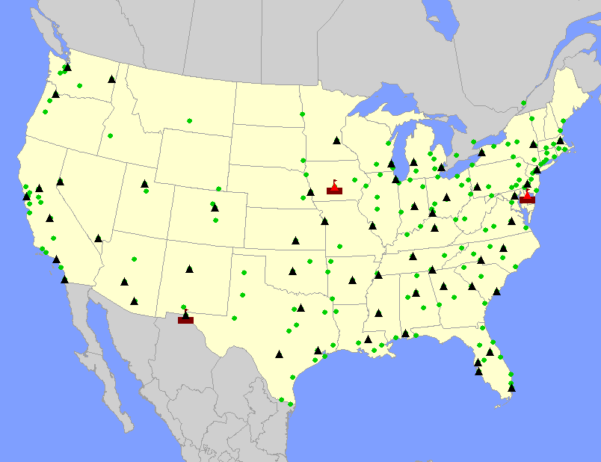
What is a Three-Echelon Supply Chain?
The Plants (the rectangles in the red boxes), must ship to the warehouses (the triangles), and the warehouses ship to customers. There is a cost for each move.
The plants are the 1st echelon, the warehouses are the 2nd echelon, and customers the 3rd. In this case, we are determining the optimal number and location of the warehouses. But, this decision must consider the cost to ship into and out of the warehouses.

Slide 57
Three-Echelon Supply Chains: We’ve Seen the Transportation Trade-Off
#1
Truck Load
LTL
#2
Truck Load
LTL

Slide 58
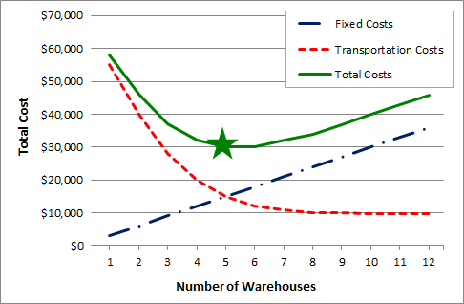
We’ve also seen the trade-off with warehouses

Slide 59
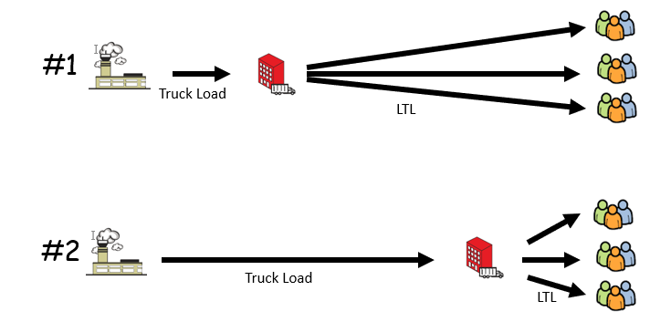
Complex Problems Have Many Trade-offs
If you are locating plants, you have a trade-off between the shipments of raw material into the plant vs shipments out of the plants (as well as the fixed cost of the plants)
You can have different-sized facilities to understand economies of scale at a facility vs being close to customers (or close to raw material)
Different costs at different locations (for example, Warehouse A is less expensive than Warehouse B)

Slide 60
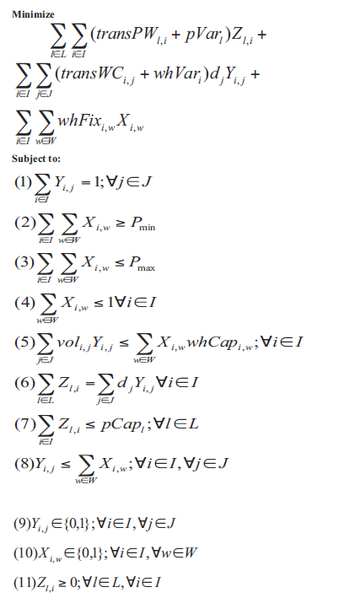
Understanding the Math Formulation
There are many ways to set this up. To keep it simple, we are modeling plants shipping to warehouses and the warehouses shipping to customers
We have unique costs for each of the different types of sites. The plant’s have their variable costs (pVar) and the warehouses have theirs (whVar)
Each site type also has unique capacity measures
The Z Decision variable is a continuous variable (it is not a 0/1 variable). It is the flow from the plants to the warehouses
Much of this you have seen before

Slide 61
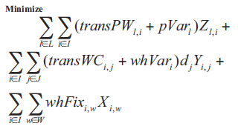
Understanding the Math Formulation: The Objective Function
1
2
3
The cost to ship to the product from the plant to the warehouse and the cost to make the item at the plant
The cost to ship the product from the warehouse to the customer and the cost to process the item at the warehouse
The fixed cost of opening the warehouse
You can expand this logic to any number of echelons

Slide 62

Understanding the Math Formulation: The Conservation of Flow (Important)
This family of constraints represents the conservation of flow
These constraints are important in any model with more than two echelons
They prevent product from just “materializing” at a warehouse, the product has to come from a plant
To read this constraint:
First, this constraint is for every warehouse i.
The equation says that the total amount of product shipped into warehouse i from every plant (this is the summation over the Z variables) must equal to the total product shipped out from warehouse i to every customer (this is the summation that includes the Y variables)

Slide 63
The same logic, applies to the location of plants relative to the raw materials and customers
Finished goods plants
Assembly locations
Customers
Suppliers
Raw Material Plants

Slide 64
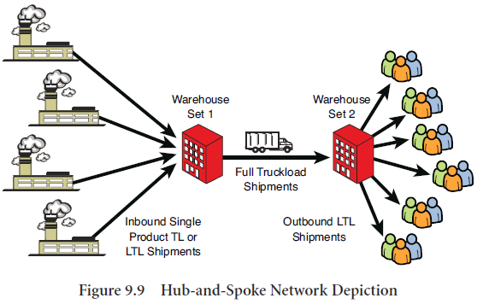
Once You Understand the Logic Of a Three-Echelon Supply Chain (conservation of flow), You can String Together Unlimited Numbers of Echelons

Slide 65
Summary- Lessons Learned
Three-Echelon modeling makes an important extension to the model– it links supply to demand through a facility (we used a warehouse as the primary example)
Three-Echelon supply chains introduce a new trade-off, between inbound and outbound transportation
Once you understand three-echelon supply chain modeling, you can extend to any number of echelons

Slide 66
End of Section

